Slide 1
MODERN OPERATING SYSTEMS
Chapter 1
Introduction
Tanenbaum, Modern Operating Systems 3e, (c) 2008 Prentice-Hall, Inc. All rights reserved. 0-13-6006639

Slide 2
What Is An Operating System?
Lots of hardware !!
One or more processors
Main memory
Disks
Printers
Various input/output devices
Managing all these components requires a layer of software – the operating system
Tanenbaum, Modern Operating Systems 3 e, (c) 2008 Prentice-Hall, Inc. All rights reserved. 0-13-6006639

Slide 3
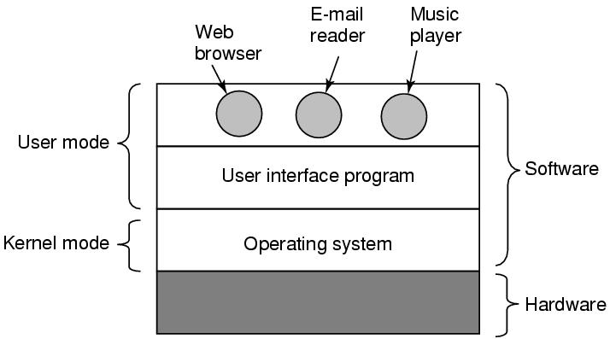
Where is the software?
Where the operating system fits in.
Tanenbaum, Modern Operating Systems 3 e, (c) 2008 Prentice-Hall, Inc. All rights reserved. 0-13-6006639

Slide 4
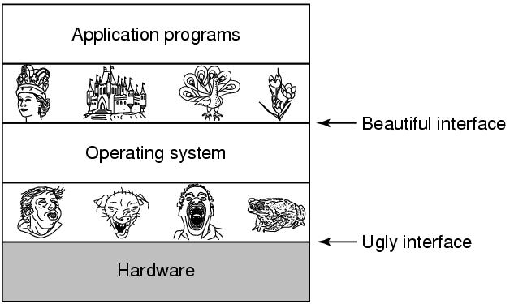
The Operating System as an Extended Machine
Tanenbaum, Modern Operating Systems 3 e, (c) 2008 Prentice-Hall, Inc. All rights reserved. 0-13-6006639

Slide 5
The Operating System as a Resource Manager
Allow multiple programs to run at the same time
Manage and protect memory, I/O devices, and other resources
Multiplexes (shares) resources in two different ways:
  In time
  In space
Tanenbaum, Modern Operating Systems 3 e, (c) 2008 Prentice-Hall, Inc. All rights reserved. 0-13-6006639

Slide 6
History of Operating Systems
Generations:
(1945–55) Vacuum Tubes
(1955–65) Transistors and Batch Systems
(1965–1980) ICs and Multiprogramming
(1980–Present) Personal Computers, Tablets, Phones
Tanenbaum, Modern Operating Systems 3 e, (c) 2008 Prentice-Hall, Inc. All rights reserved. 0-13-6006639

Slide 7
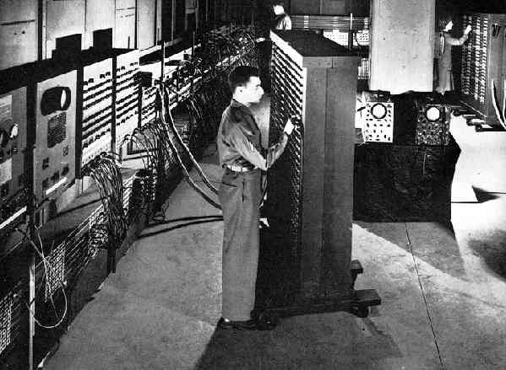
Vacuum Tubes

Slide 8
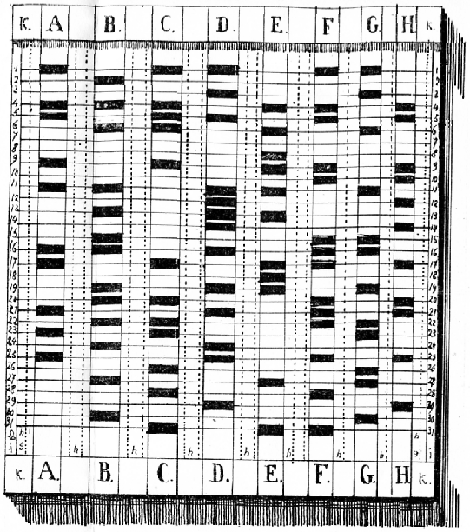
Punch card

Slide 9

Transistors and Batch Systems (1)
Figure 1-3. An early batch system.
(a) Programmers bring cards to 1401.
(b)1401 reads batch of jobs onto tape.
Tanenbaum, Modern Operating Systems 3 e, (c) 2008 Prentice-Hall, Inc. All rights reserved. 0-13-6006639

Slide 10
Transistors and Batch Systems (2)
Figure 1-3. (c) Operator carries input tape to 7094.
(d) 7094 does computing. (e) Operator carries output tape to 1401. (f) 1401 prints output.
Tanenbaum, Modern Operating Systems 3 e, (c) 2008 Prentice-Hall, Inc. All rights reserved. 0-13-6006639

Slide 11
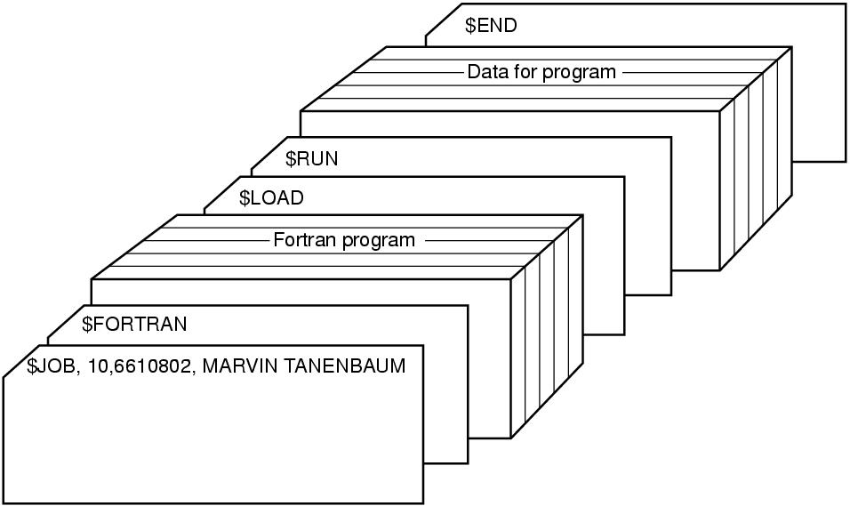
Transistors and Batch Systems (4)
Figure 1-4. Structure of a typical FMS job.
Tanenbaum, Modern Operating Systems 3 e, (c) 2008 Prentice-Hall, Inc. All rights reserved. 0-13-6006639

Slide 12

ICs and Multiprogramming
Figure 1-5. A multiprogramming system
with three jobs in memory.
Tanenbaum, Modern Operating Systems 3 e, (c) 2008 Prentice-Hall, Inc. All rights reserved. 0-13-6006639
Notes:
MULTICS
Timesharing CTSS (MIT)
Multics
UNix

Slide 13
More third generation
Time Sharing (Compatible Time Sharing System)
MULTICS ( MULTiplexed Information and Computing Service)
UNIX – POSIX and MINIX
LINUX
.
Tanenbaum, Modern Operating Systems 3 e, (c) 2008 Prentice-Hall, Inc. All rights reserved. 0-13-6006639
Notes:
MULTICS
Timesharing CTSS (MIT)
Multics
UNix

Slide 14
Fourth generation
PCs
Network Operating Systems
Distributed Operating Systems
.
Tanenbaum, Modern Operating Systems 3 e, (c) 2008 Prentice-Hall, Inc. All rights reserved. 0-13-6006639
Notes:
MULTICS
Timesharing CTSS (MIT)
Multics
UNix

Slide 15
Fifth generation – mobile computer
PDA (Personal Digital Assistant)
iPhone
Smart phone
.
Tanenbaum, Modern Operating Systems 3 e, (c) 2008 Prentice-Hall, Inc. All rights reserved. 0-13-6006639
Notes:
MULTICS
Timesharing CTSS (MIT)
Multics
UNix

Slide 16
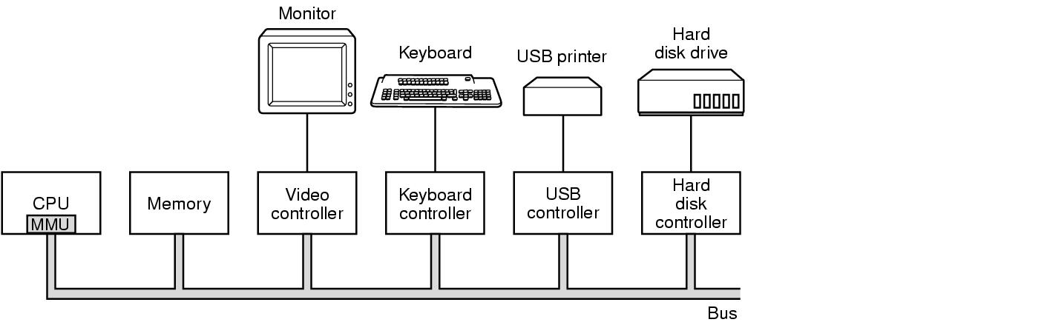
Computer Hardware Review
Some of the components
of a simple personal computer.
Tanenbaum, Modern Operating Systems 3 e, (c) 2008 Prentice-Hall, Inc. All rights reserved. 0-13-6006639

Slide 17
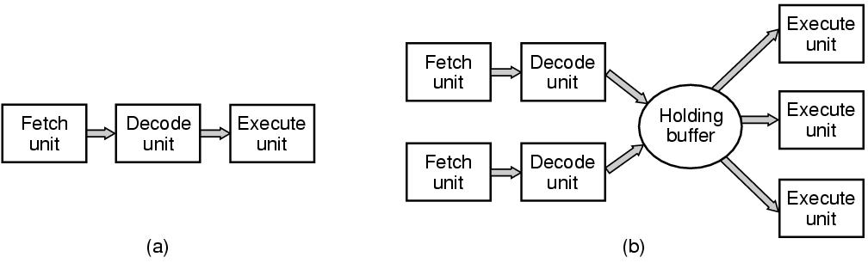
CPU Pipelining
Figure 1-7. (a) A three-stage pipeline. (b) A superscalar CPU.
Tanenbaum, Modern Operating Systems 3 e, (c) 2008 Prentice-Hall, Inc. All rights reserved. 0-13-6006639

Slide 18
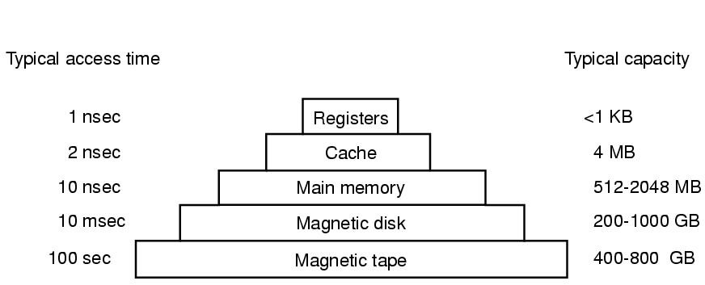
Memory Hierarchy
A typical memory hierarchy.
The numbers are very rough approximations.
Tanenbaum, Modern Operating Systems 3 e, (c) 2008 Prentice-Hall, Inc. All rights reserved. 0-13-6006639

Slide 19
Caches
Main memory is divided into cache lines (64 bytes)
  0-63 in line 1, 64-127 in line 2
When program reads a word-cache hardware checks to see if in cache.
  If so, then have a cache hit (2 cycles).
  Otherwise, make request of main memory over the bus (expensive)
Cache is expensive and is therefore limited in size
Can have cache hierarchies
Cache other things, like URL addresses
Tanenbaum, Modern Operating Systems 3 e, (c) 2008 Prentice-Hall, Inc. All rights reserved. 0-13-6006639

Slide 20
The 4 Cache Questions
When to put a new item into the cache? (on a cache miss)
Which cache line to put the new item in? (memory word determines which line)
Which item to remove from the cache when a slot is needed? (same line new data goes into)
Where to put a newly evicted item in main memory? (memory address determines this)
Tanenbaum, Modern Operating Systems 3 e, (c) 2008 Prentice-Hall, Inc. All rights reserved. 0-13-6006639

Slide 21
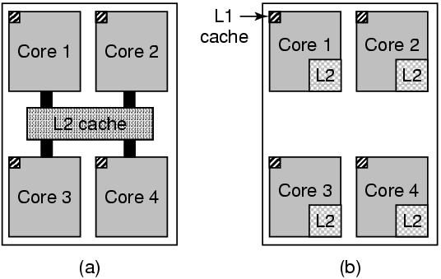
Multithreaded and Multicore Chips
(a) A quad-core chip with a shared L2 cache.
(b) A quad-core chip with separate L2 caches.
Tanenbaum, Modern Operating Systems 3 e, (c) 2008 Prentice-Hall, Inc. All rights reserved. 0-13-6006639

Slide 22
Main Memory
RAM
ROM-can’t be changed. Fast, cheap
  eg.-keeps bootstrap OS loader
EEPROM (Electrically Erasable PROM) Can be re-written, but slowly
  E.g.- Memory stick serves as films in digital cameras, as disk in portable music players
.
Tanenbaum, Modern Operating Systems 3 e, (c) 2008 Prentice-Hall, Inc. All rights reserved. 0-13-6006639
Notes:
MULTICS
Timesharing CTSS (MIT)
Multics
UNix

Slide 23
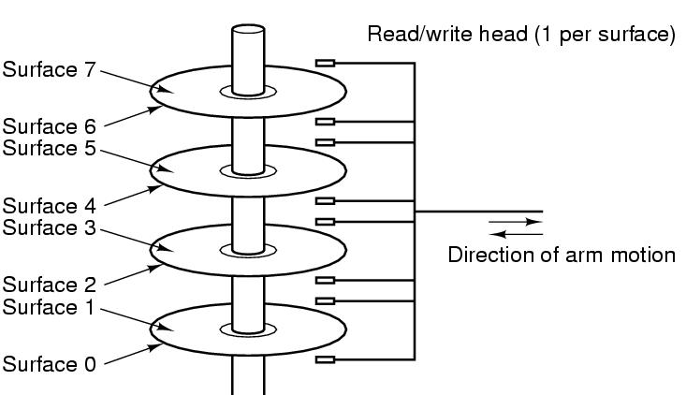
Disks
Tracks are divided into sectors (512 bytes)
Multiple tracks form a cylinder.
Tanenbaum, Modern Operating Systems 3 e, (c) 2008 Prentice-Hall, Inc. All rights reserved. 0-13-6006639

Slide 24
I/O Devices
Controller runs a device-accepts commands from the OS and executes them
Complicated business
  Eg. Gets command to read sector x on disk y. Must convert to (cylinder, sector, head) address, move arm to correct cylinder, wait for sector to rotate under the head, read and store bits coming off the drive, compute checksum, store bits as words in memory
  Controller contains a computer to run its device
Tanenbaum, Modern Operating Systems 3 e, (c) 2008 Prentice-Hall, Inc. All rights reserved. 0-13-6006639

Slide 25
Device Driver
OS software that talks to controller-gives commands, accepts responses
Each controller manufacturer supplies a driver for each OS
Driver runs in kernel mode
Controller has registers which are used to communicate with the driver
Three modes of communication
    Polling
    Interrupts
    DMA
Tanenb aum, Modern Operating Systems 3 e, (c) 2008 Prentice-Hall, Inc. All rights reserved. 0-13-6006639

Slide 26
I/O by polling device
Driver issues command to controller
Driver polls device until it is ready
Eg Send character to printer controller and poll until it is ready to accept the next character
Big use of CPU
Called programmed I/O-not really used any more
Tanenbaum, Modern Operating Systems 3 e, (c) 2008 Prentice-Hall, Inc. All rights reserved. 0-13-6006639

Slide 27
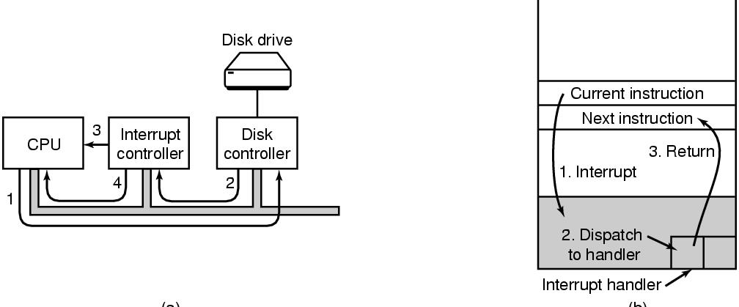
I/O by Interrupts
Generate an interrupt when I/O is finished.
Eg When character is finished being printed, interrupt CPU. Allows CPU to do something else while character is being printed
Tanenbaum, Modern Operating Systems 3 e, (c) 2008 Prentice-Hall, Inc. All rights reserved. 0-13-6006639

Slide 28
I/O by DMA
Special (controller) chip
Avoids using the CPU as part of the transfer to/from memory
CPU tells chip to set up transfer and take care of it
Chip does as it it told and interrupts CPU when it is finished
Tanenbaum, Modern Operating Systems 3 e, (c) 2008 Prentice-Hall, Inc. All rights reserved. 0-13-6006639

Slide 29
The bus hierarchy
In the beginning there was one bus-couldn’t handle the traffic when cpu and memories got faster and bigger
Create a hierarchy of faster buses (PCI) and specialized buses (SCSI, USB)
Tanenbaum, Modern Operating Systems 3 e, (c) 2008 Prentice-Hall, Inc. All rights reserved. 0-13-6006639

Slide 30
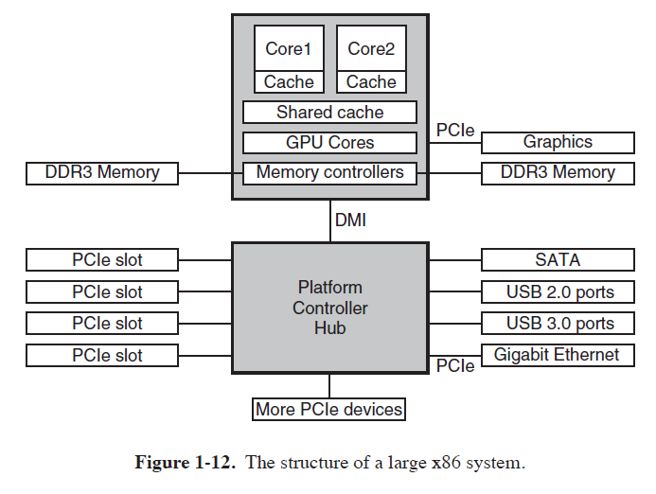
Pentium System Buses
The structure of a large Pentium system
Tanenbaum, Modern Operating Systems 3 e, (c) 2008 Prentice-Hall, Inc. All rights reserved. 0-13-6006639

Slide 31
The Operating System Zoo
Mainframe operating systems
  Big-thousands of disks….
  Lots of jobs with lots of I/O
  Services-batch (payroll) transactions (airline reservations, timesharing (query database)
  Elderly-Unix, Linux replacing them
Tanenbaum, Modern Operating Systems 3 e, (c) 2008 Prentice-Hall, Inc. All rights reserved. 0-13-6006639

Slide 32
The Operating System Zoo
Server operating systems
  Workstations
  File, print, web servers
  BSD, Linux, Windows
Multiprocessor operating systems
  Use multiple cores
Tanenbaum, Modern Operating Systems 3 e, (c) 2008 Prentice-Hall, Inc. All rights reserved. 0-13-6006639

Slide 33
The Operating System Zoo
PC operating systems-Linux, Mac, Windows
Smart phone operating systems- Android, iPhone, Blackberry
  No hard disk
  Palm, Symbian popular OS’s
Tanenbaum, Modern Operating Systems 3 e, (c) 2008 Prentice-Hall, Inc. All rights reserved. 0-13-6006639

Slide 34
The Operating System Zoo
Embedded operating systems-TV sets, cars, DVDs, MP3s
  Everything is in ROM (no apps can run on it)
  QNx, Vxworks
Real time operating systems
  Hard (eg. factory) deadline
  Soft (eg. multi-media) deadline
Smart card OS (eg border crossing cards)
    Java in ROM
Tanenbaum, Modern Operating Systems 3 e, (c) 2008 Prentice-Hall, Inc. All rights reserved. 0-13-6006639

Slide 35
Operating System Concepts
Processes
Address spaces
Files
Input/Output
Protection
The shell
Tanenbaum, Modern Operating Systems 3 e, (c) 2008 Prentice-Hall, Inc. All rights reserved. 0-13-6006639

Slide 36
Processes
Program in execution
  Container that holds all the information needed to run a program
Lives in address space
  Contain executable program, data and stack
Process table
  Keeps info about process
  Used to re-start process
Shell (command interpreter) reads commands from terminal
Tanenbaum, Modern Operating Systems 3 e, (c) 2008 Prentice-Hall, Inc. All rights reserved. 0-13-6006639

Slide 37

A Process Tree
Process creates child processes
Tree structure
Tanenbaum, Modern Operating Systems 3 e, (c) 2008 Prentice-Hall, Inc. All rights reserved. 0-13-6006639

Slide 38
Process
Have UID’s and group ID’s (GID)
Can communicate with one another (IPC)
Tanenbaum, Modern Operating Systems 3 e, (c) 2008 Prentice-Hall, Inc. All rights reserved. 0-13-6006639

Slide 39
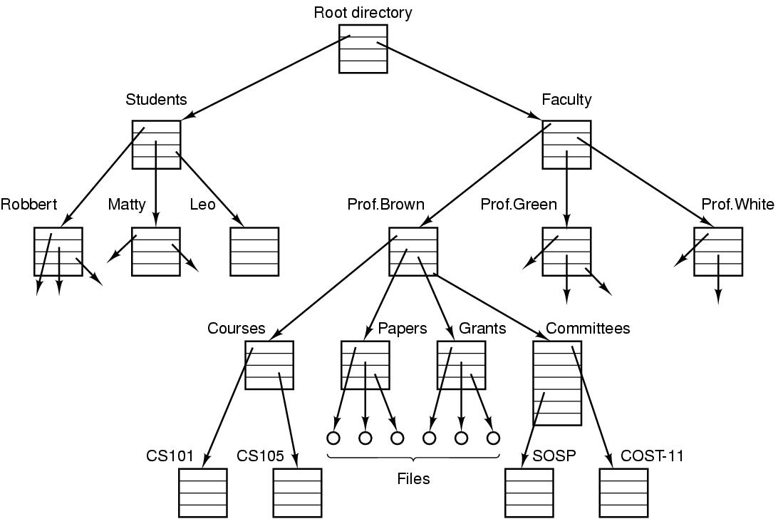
File directory
  The directory is organized as a tree
  Root directory at the top. Path proceeds from the root (e.g. faculty/prof brown/courses)
Tanenbaum, Modern Operating Systems 3 e, (c) 2008 Prentice-Hall, Inc. All rights reserved. 0-13-6006639

Slide 40
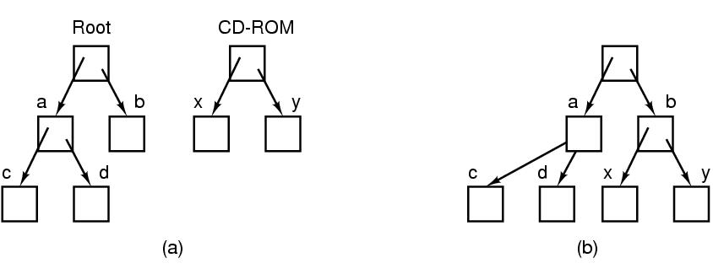
Mounting Files in UNIX
A CD-ROM is mounted on directory b.
Tanenbaum, Modern Operating Systems 3 e, (c) 2008 Prentice-Hall, Inc. All rights reserved. 0-13-6006639

Slide 41
Special files
Special files-can use same calls for I/O as for files. OS treats them as files.
  Block special files (disks)
  Character special files (line printers, modems)
  Kept in /dev directory, e.g. /dev/lp is line printer
Tanenbaum, Modern Operating Systems 3 e, (c) 2008 Prentice-Hall, Inc. All rights reserved. 0-13-6006639

Slide 42
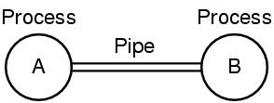
Unix Pipe
Processes communicate by writing into/reading from a file in Unix
A and B write into the pipe and read from the pipe.
Tanenbaum, Modern Operating Systems 3 e, (c) 2008 Prentice-Hall, Inc. All rights reserved. 0-13-6006639

Slide 43
I/O, Protection/Shell
I/O-big part of OS
Protection-UNIX uses rwx bits for each file
  3 bits for owner, 3 for group, 3 for everyone else
Shell (command interpreter)
  UNIX
  Has lots of flavors-sh, bash, csh, ssh…..
  Sort<file1>file2
  Cat file 1 file 2 file3 | sort > /dev/lp
Tanenbaum, Modern Operating Systems 3 e, (c) 2008 Prentice-Hall, Inc. All rights reserved. 0-13-6006639

Slide 44
System Calls
Interface between user programs and OS
Varies from OS to OS
System call issued by user program
Call uses a library call of the same name
Library routine puts machine into kernel modes (by issuing a special instruction)
Finds actual routine for system call in a table
Does the work involved in the call
Returns to user program
Tanenbaum, Modern Operating Systems 3 e, (c) 2008 Prentice-Hall, Inc. All rights reserved. 0-13-6006639

Slide 45
Unix Read System Call
Count=read(fd, buffer, nbytes)
  fd is a file descriptor. When a file is opened, permissions are checked. If access is allowed, a number (fd) is returned. Then file can be read/written
  nbytes is number of bytes in file
  buffer is where read deposits the bytes
Tanenbaum, Modern Operating Systems 3 e, (c) 2008 Prentice-Hall, Inc. All rights reserved. 0-13-6006639

Slide 46

System Calls
read(fd, buffer, nbytes).
Tanenbaum, Modern Operating Systems 3 e, (c) 2008 Prentice-Hall, Inc. All rights reserved. 0-13-6006639

Slide 47
Look at System Calls
Start with process management
  See how they are used in shell
  Then you write a shell
Then do a brief summary of calls for
  File management
  Other useful calls
Tanenbaum, Modern Operating Systems 3 e, (c) 2008 Prentice-Hall, Inc. All rights reserved. 0-13-6006639

Slide 48
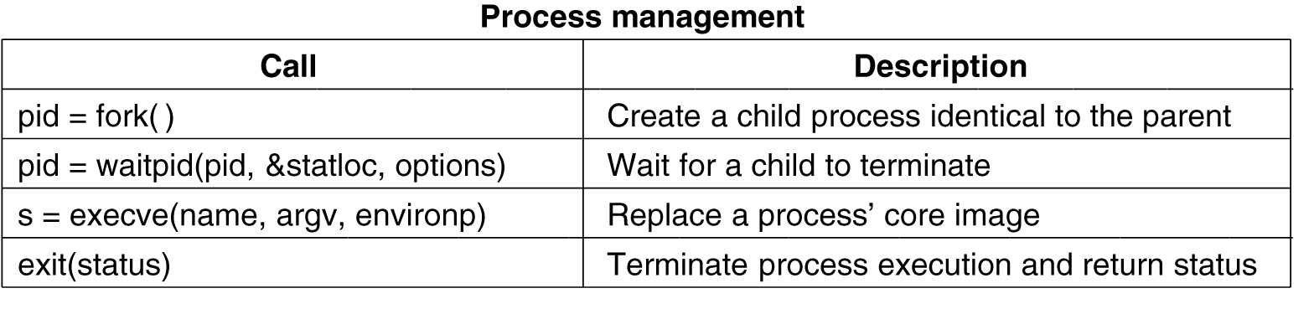
System Calls for Process Management
Tanenbaum, Modern Operating Systems 3 e, (c) 2008 Prentice-Hall, Inc. All rights reserved. 0-13-6006639

Slide 49
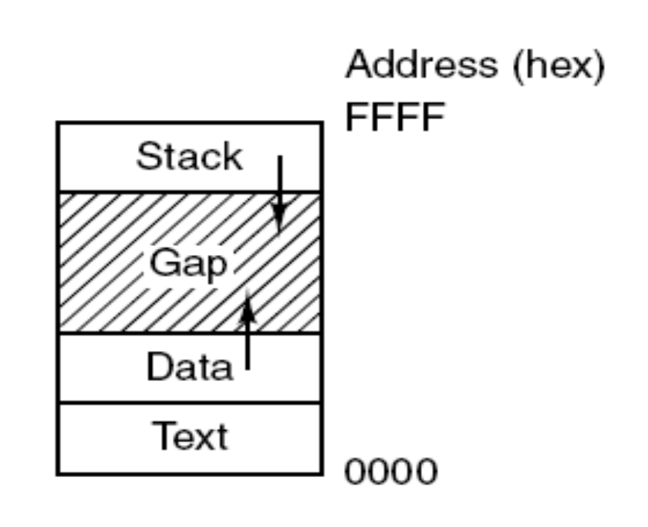
Memory Layout
Processes have three segments:
text, data, and stack.
Tanenbaum, Modern Operating Systems 3 e, (c) 2008 Prentice-Hall, Inc. All rights reserved. 0-13-6006639

Slide 50
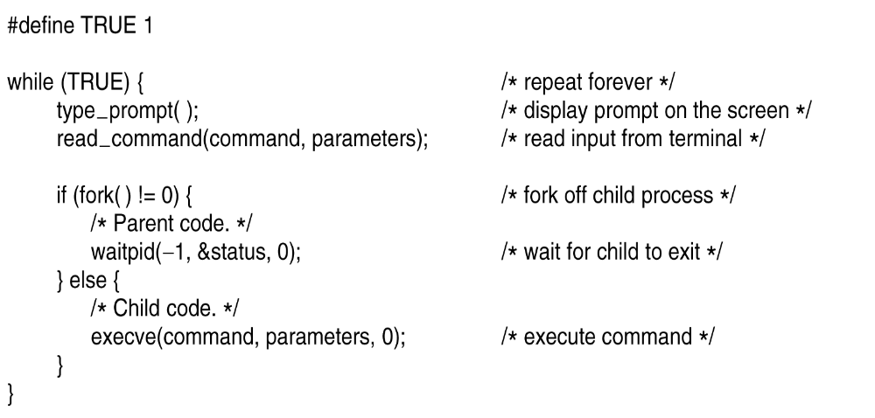
Shell
.
Tanenbaum, Modern Operating Systems 3 e, (c) 2008 Prentice-Hall, Inc. All rights reserved. 0-13-6006639

Slide 51
Fork
Pid=fork( )
  Duplicates parent process completely Everything duplicated -data,registers,fd’s
  Fork returns a value (pid)
    Zero in child
    Child’s PID in parent
    Used to differentiate child from parent
Tanenbaum, Modern Operating Systems 3 e, (c) 2008 Prentice-Hall, Inc. All rights reserved. 0-13-6006639

Slide 52
Execve
Replaces process’ core image by the file named in its invocation
Execve(name,arg,environp) has 3 parameters
  Name of file (e.g. cp command)
  Arg-pointer to argument array
  Environp-pointer to environment array
Tanenbaum, Modern Operating Systems 3 e, (c) 2008 Prentice-Hall, Inc. All rights reserved. 0-13-6006639

Slide 53
Excve (example)
Cp f1 f2 is located by execve and parameters are passed to it by execve
  Main(argc, argv, envp) is main prog in cp
    Argc is #items on command line (=3 in cp)
    Argv points to array (arg[0] points to cp, arg[1] points to f1,
    Envp points to environment, an array of name=value with info like terminal type
Tanenbaum, Modern Operating Systems 3 e, (c) 2008 Prentice-Hall, Inc. All rights reserved. 0-13-6006639

Slide 54
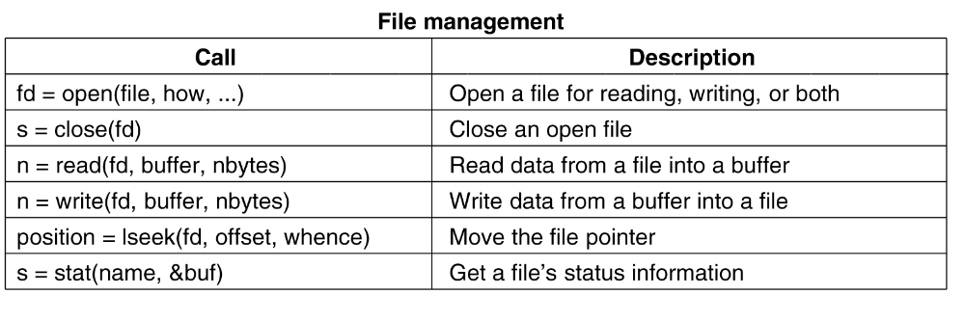
System Calls for File Management
Tanenbaum, Modern Operating Systems 3 e, (c) 2008 Prentice-Hall, Inc. All rights reserved. 0-13-6006639

Slide 55
File mode
System keeps track of it
  Regular, special
  Date of creation
  Size
  Access status of file via stat command
Tanenbaum, Modern Operating Systems 3 e, (c) 2008 Prentice-Hall, Inc. All rights reserved. 0-13-6006639

Slide 56
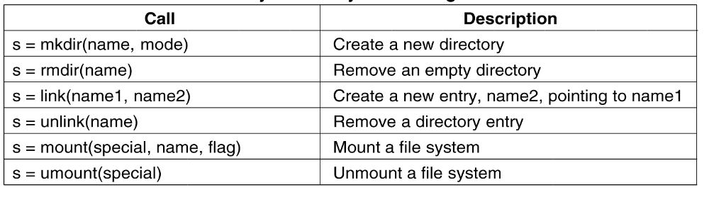
System Calls for Directory and File Management
.
Tanenbaum, Modern Operating Systems 3 e, (c) 2008 Prentice-Hall, Inc. All rights reserved. 0-13-6006639

Slide 57
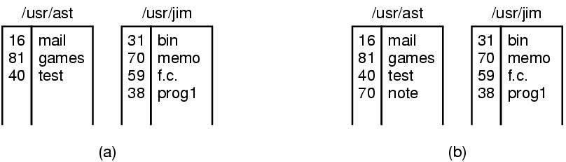
Linking
link("/usr/jim/memo", "/usr/ast/note");
In Unix, each file is identified by an i-number
i-number indexes into i-node table
  Link creates a new directory entry with same i-number
  Has a new name (note instead of memo)
Tanenbaum, Modern Operating Systems 3 e, (c) 2008 Prentice-Hall, Inc. All rights reserved. 0-13-6006639

Slide 58
Mount System Call
mount(“/dev/fd0”, “/mnt”, 0) is system call
File comes from drive 0 and is mounted on binary file /mnt.
Third parameter tells if it is read or read-write
Result is that file on drive zero can be accessed from a directory
Saw this example before with CD-same mechanism for memory sticks and portions of hard drives
Tanenbaum, Modern Operating Systems 3 e, (c) 2008 Prentice-Hall, Inc. All rights reserved. 0-13-6006639

Slide 59
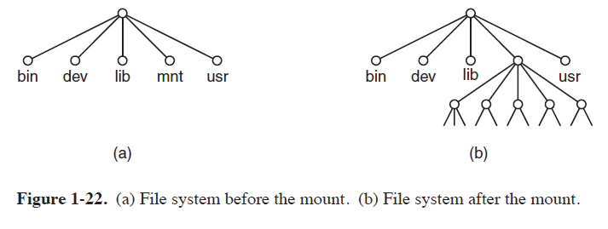
Mount System Call

Slide 60
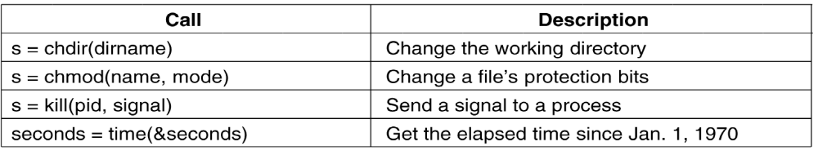
Other System Calls
Tanenbaum, Modern Operating Systems 3 e, (c) 2008 Prentice-Hall, Inc. All rights reserved. 0-13-6006639

Slide 61
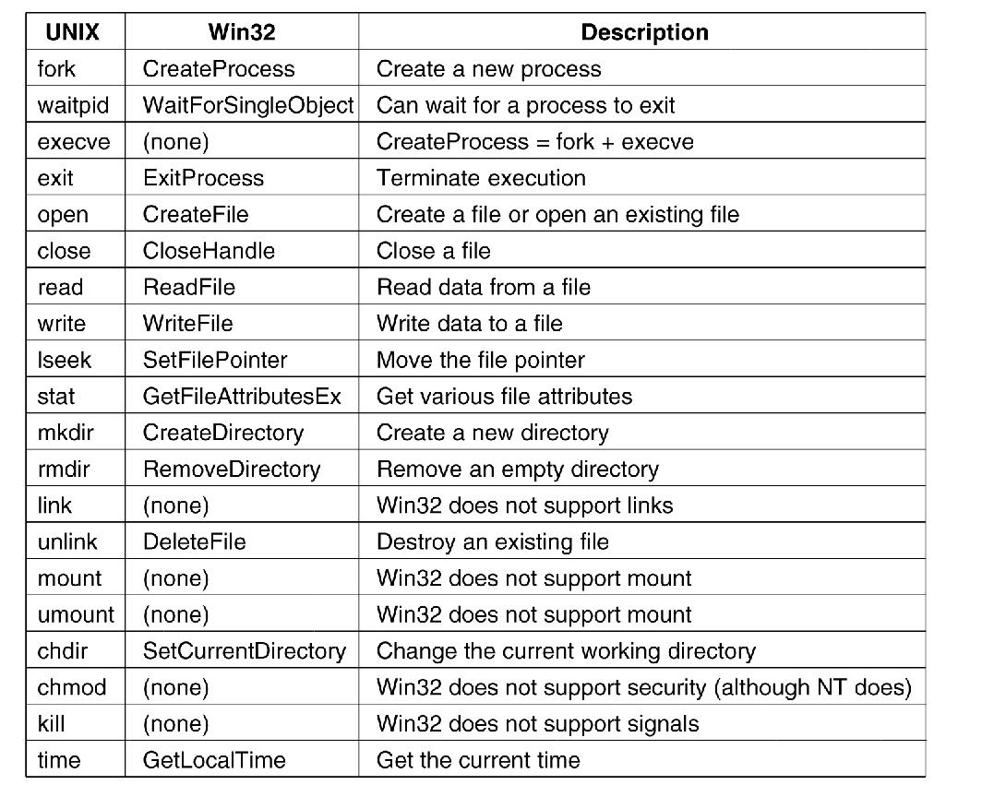
Windows Win32 API
The Win32 API calls that roughly correspond
to the UNIX calls
Tanenbaum, Modern Operating Systems 3 e, (c) 2008 Prentice-Hall, Inc. All rights reserved. 0-13-6006639

Slide 62
Operating Systems Structure
Low level software system that
  – manages all applications
  – implements an interface between applications and resources
– manages available resources
Resource manager
Interface
Virtual Machine

Slide 63
Operating Systems Structure
Requirements
Portable
- Applications and OS should run on different systems
Linux can be executed in different HW architectures
Cross platform application can execute in different OS (Linux/Unix/MAC OS X)

Slide 64
Operating Systems Structure
Requirements
Performance
– the use of available resources should be efficient
Security
– users and processes should work independently, although sharing resources
Ease of use
– The programming interface should be simple but expressive

Slide 65
Operating Systems Structure
A general purpose OS is composed of:
Process manager
Multiplexes the CPU time between the multiple execution units (processes)
Memory manager
controls, manages and multiplexes the access to physical and virtual memory
Inter-process communication
Implements and handles mechanism for processes to communicate

Slide 66
Operating Systems Structure
A general purpose OS is composed of:
I/O manager
manages communication with peripheral (keyboard/screen, disk, network)
User interface
command line interpreter
GUI

Slide 67
Operating Systems Structure
A general purpose OS is composed of:
File System manager
manages and organizes data available on disks (file
systems)
Function calls
Programming functions that allow applications to use OS services (memory, disk, I/O)

Slide 68
Operating Systems Structure
A general purpose OS can be divided in:
– OS kernel
Code executed in privileged mode
– User space
Code executed in non privileged mode
– Service /daemon
Application that executed in the background (server)
– Utility programs
Application provided by the OS and executed by the user (editor, shell, compiler)

Slide 69
Operating Systems Structure
A general purpose OS can be divided in:
– System calls
functions that implement parts of the OS services or utilities
can be used inside the kernel
Manage and change internal structure.
– C lib
set of user level functions

Slide 70
Operating Systems Structure
Types:
Monolithic
Layered
Micro kernel
Distributed
VM based
The Java Virtual Machine
Exokernels

Slide 71
Monolithic Operating Systems Structure
OS composed of a single module
  -All kernel routines are together
  -All data and code use same memory space
A system call interface
Examples:
  – Linux, BSD Unix
  – Windows NT (hybrid)

Slide 72
Monolithic Operating Systems Structure
Pros
  – Performance is good if the program runs well.
  – Shared kernel space
  - Easy to implement
  - Low overheads
Cons
  – low security mechanisms (one driver can mess other drivers)
  – Difficult to evolve (reboot of system needed)

Slide 73
Monolithic Operating Systems Structure
How kernel works
A main program that invokes the requested service procedure.
A set of service procedures that carry out the system calls.
A set of utility procedures that help the service procedures.
Tanenbaum, Modern Operating Systems 3 e, (c) 2008 Prentice-Hall, Inc. All rights reserved. 0-13-6006639

Slide 74
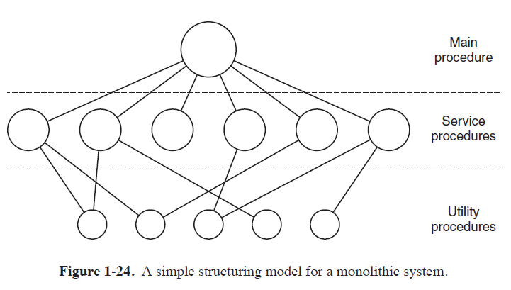
Operating Systems Structure

Slide 75
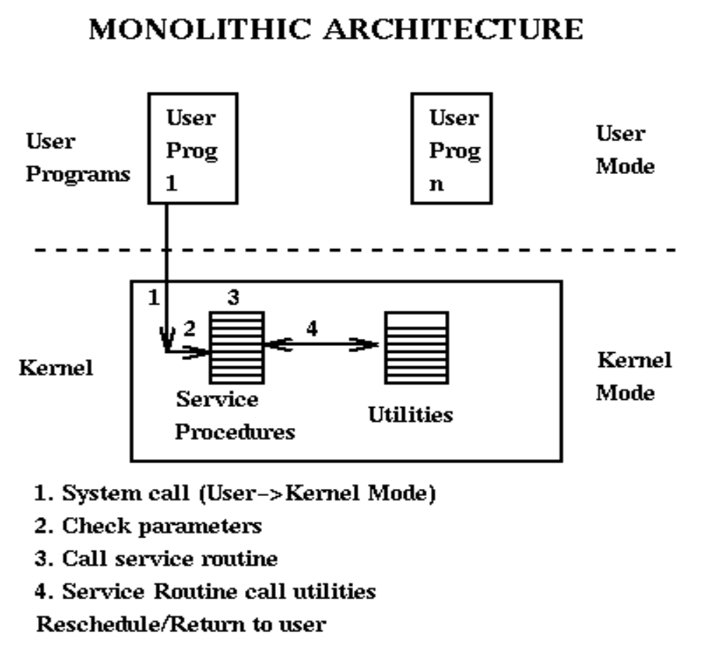
Monolithic Operating Systems Structure

Slide 76
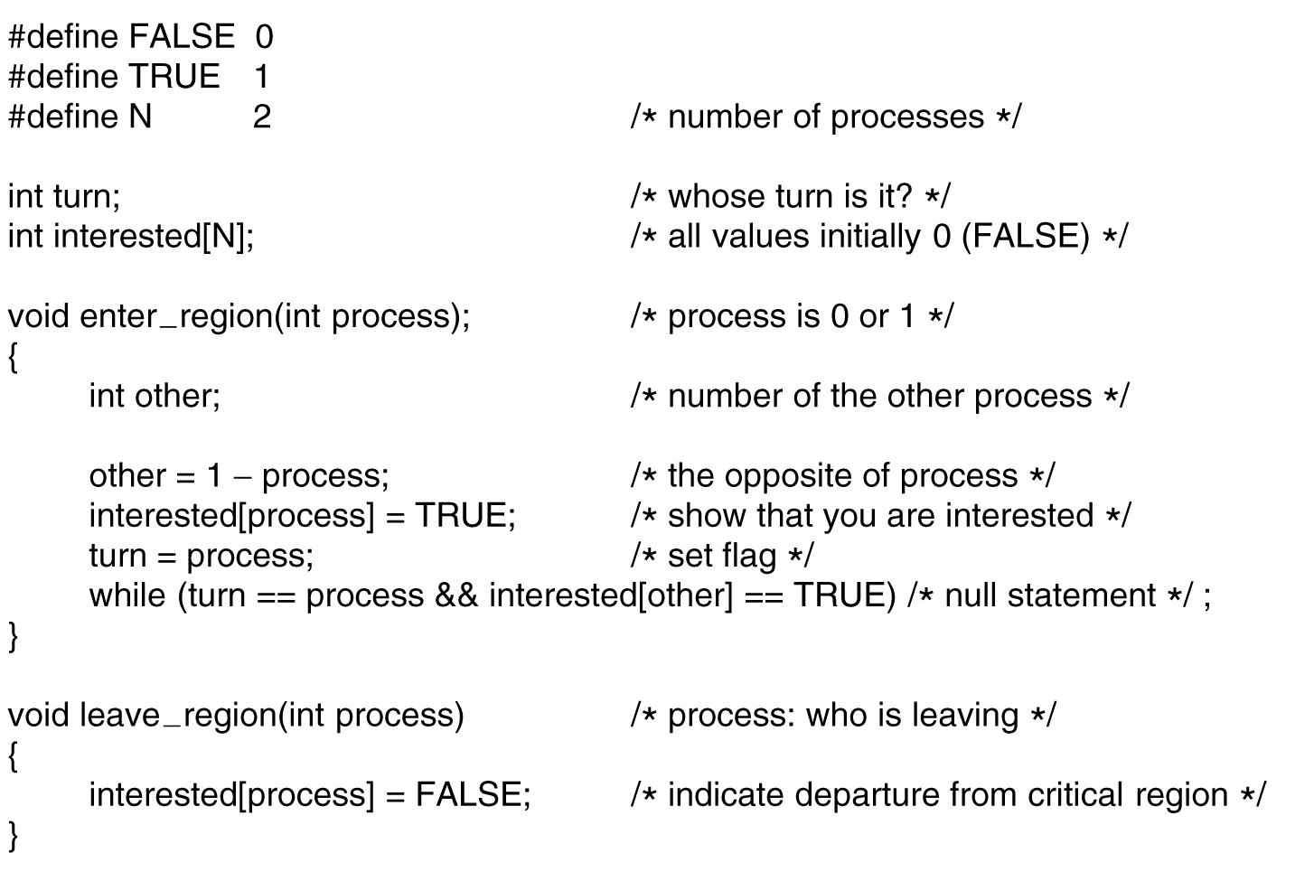
Monolithic Systems
A simple structuring model for a monolithic system.
Tanenbaum, Modern Operating Systems 3 e, (c) 2008 Prentice-Hall, Inc. All rights reserved. 0-13-6006639

Slide 77
Layered Systems- operating system
Components are divided into layers
– grouping similar components
Each layer only interacts with:
– the bottom layer - requesting services
– to top layer - answering requests
Higher level layer
– Applications
Tanenbaum, Modern Operating Systems 3 e, (c) 2008 Prentice-Hall, Inc. All rights reserved. 0-13-6006639

Slide 78
Layered Systems- operating system
lowest level layer
– hardware
Advantaged
– good structure, well defined interface, ...
Disadvantages
– can be slow, may be difficult to define layers.
Tanenbaum, Modern Operating Systems 3 e, (c) 2008 Prentice-Hall, Inc. All rights reserved. 0-13-6006639

Slide 79
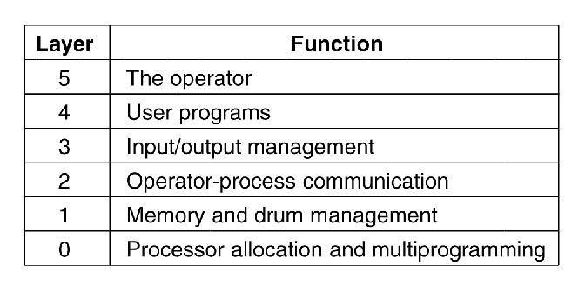
Layered Systems-THE operating system
Dijkstra’s the author
Tanenbaum, Modern Operating Systems 3 e, (c) 2008 Prentice-Hall, Inc. All rights reserved. 0-13-6006639

Slide 80
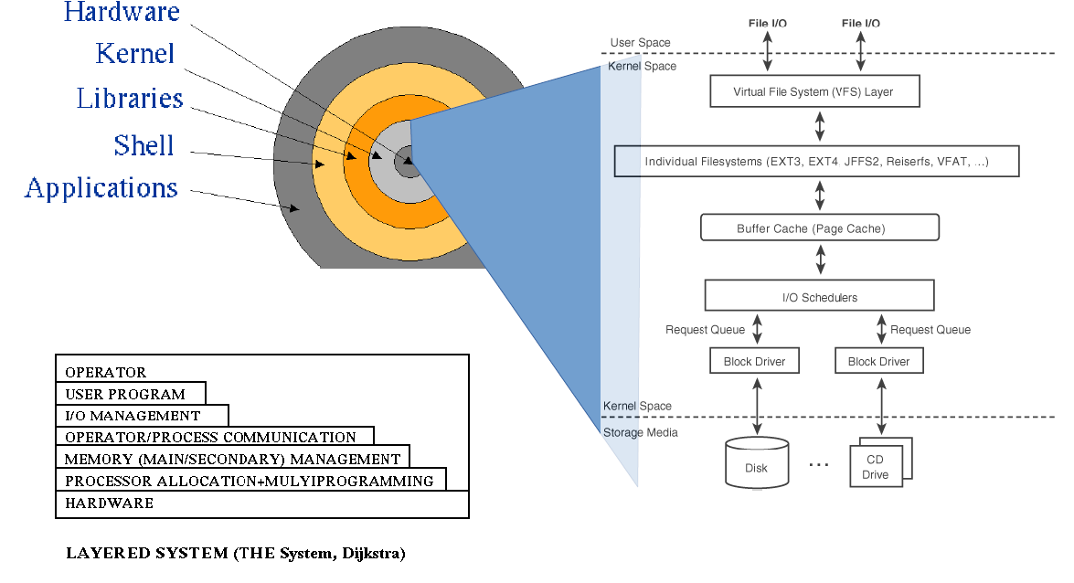
Layered Systems-THE operating system
Operating Systems Structure

Slide 81
Microkernels
Removes from kernel as much functionality as possible,
– limiting the amount of code executed in privileged mode
– allow easy modifications and extensions
Most microkernels provide basic process and memory management, and message passing between other services
Security and protection can be enhanced
– most services are performed in user mode, not kernel mode.
Tanenbaum, Modern Operating Systems 3 e, (c) 2008 Prentice-Hall, Inc. All rights reserved. 0-13-6006639

Slide 82
Microkernels
System expansion can also be easier,
– only involves adding more system applications, not rebuilding a new kernel.
Windows NT was originally microkernel
– but suffered from performance problems relative to Windows 95.
– NT 4.0 improved performance by moving more services into the kernel
Multiple OS can be built on top of a micro-kernel
– Each operating system will make use of different system processes.
Tanenbaum, Modern Operating Systems 3 e, (c) 2008 Prentice-Hall, Inc. All rights reserved. 0-13-6006639

Slide 83
Microkernels
Small number of processes are allowed in the kernel
Minimizes effects of bugs
  Don’t want bug in driver to crash system
Put mechanism in kernel and policy outside the kernel
  Mechanism- schedule processes by priority scheduling algorithm
  Policy-assign process priorities in user space
Tanenbaum, Modern Operating Systems 3 e, (c) 2008 Prentice-Hall, Inc. All rights reserved. 0-13-6006639

Slide 84
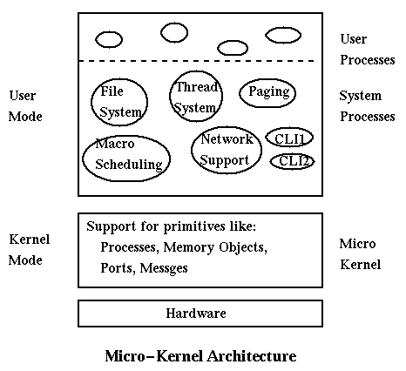
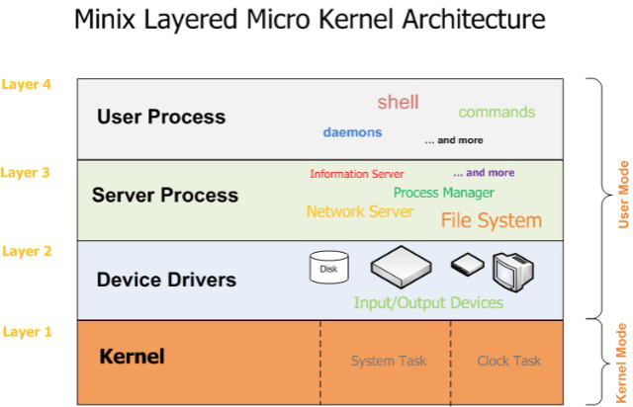
Microkernels
Structure of the MINIX 3 system.
Tanenbaum, Modern Operating Systems 3 e, (c) 2008 Prentice-Hall, Inc. All rights reserved. 0-13-6006639

Slide 85
Distributed OS
Each component/service is a separated process
– on the same machine
– on different machines
Components interactions
– messages / Remote procedures
Distributed File System
Distributed memory
Distributed processes

Slide 86
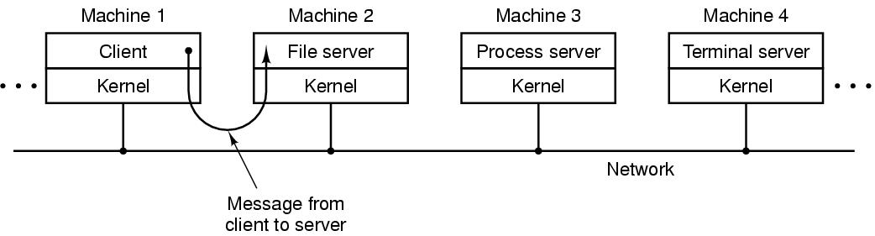
Client-Server Model
The client-server model over a network.
Tanenbaum, Modern Operating Systems 3 e, (c) 2008 Prentice-Hall, Inc. All rights reserved. 0-13-6006639

Slide 87
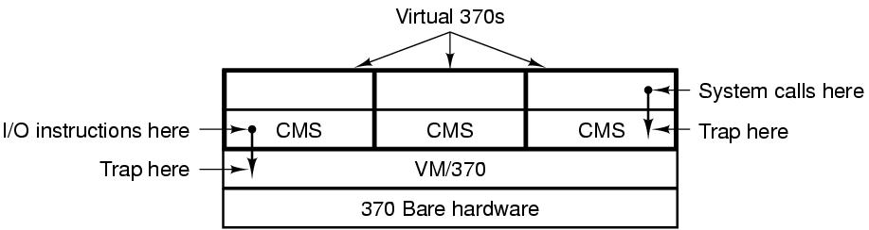
Virtual Machines (1)
The structure of VM/370 with CMS.
Tanenbaum, Modern Operating Systems 3 e, (c) 2008 Prentice-Hall, Inc. All rights reserved. 0-13-6006639

Slide 88
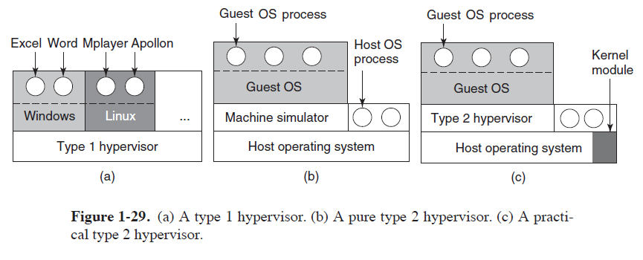
Virtual Machines (2)
Tanenbaum, Modern Operating Systems 3 e, (c) 2008 Prentice-Hall, Inc. All rights reserved. 0-13-6006639

Slide 89




Virtual Machines (2)
1st Generation: Full virtualization (Binary rewriting)
  Software Based
  VMware and Microsoft
2nd Generation: Paravirtualization
  Cooperative virtualization
  Modified guest
  VMware, Xen
3rd Generation: Silicon-based (Hardware-assisted) virtualization
  Unmodified guest
  VMware and Xen on virtualization-aware hardware platforms
Virtual
Machine
Virtual
Machine
…
Dynamic Translation
VM
…
VM
Virtual
Machine
Virtual
Machine
Hypervisor
…
Operating System
Hypervisor
Hardware
Hardware
Hardware
Time
Virtualization Logic
Notes:
Virtual Machine Monitor
Each virtual machine interfaces with its host system via the virtual machine monitor (VMM). Being the primary link between a VM and the host OS and hardware, the VMM provides a crucial role. The VMM primarily:
Presents emulated hardware to the virtual machine
Isolates VMs from the host OS and from each other
Throttles individual VM access to system resources, preventing an unstable VM from impacting system performance
Passes hardware instructions to and from the VM and the host OS/hypervisor
When full virtualization is employed, the VMM will present a complete set of emulated hardware to the VM's guest operating system. This includes the CPU, motherboard, memory, disk, disk controller, and network cards. For example, Microsoft Virtual Server 2005 emulates an Intel 21140 NIC card and Intel 440BX chipset. Regardless of the actual physical hardware on the host system, the emulated hardware remains the same.
The next significant role of the VMM is to provide isolation. The VMM has full control of the physical host system's resources, leaving individual virtual machines with access only to their emulated hardware resources. The VMM contains no mechanisms for inter-VM communication, thus requiring that two virtual machines wishing to exchange data do so over the network.
Another major role of the VMM is to manage host system resource access. This is important, as it can prevent over-utilization of one VM from starving out the performance of other VMs on the same host. Through the system configuration console, system hardware resources such as the CPU, network, and disk access can be throttled, with maximum usage percentages assigned to each individual VM. This allows the VMM to properly schedule access to host system resources as well as to guarantee that critical VMs will have access to the amount of hardware resources they need to sustain their operations.
Host OS/Hypervisor
The primary role of the host operating system or hypervisor is to work with the VMM to coordinate access to the physical host system's hardware resources. This includes scheduling access to the CPU as well as the drivers for communication with the physical devices on the host, such as its network cards.
The term hypervisor is used to describe a lightweight operating shell that has the sole purpose of providing VM hosting services. The hypervisor differs from a traditional OS in that the OS may be designed for other roles on the network. As it is tailored to VM hosting, a hypervisor solution generally offers better performance and should have fewer security vulnerabilities because it runs few services and contains only essential code. Hypervisors written for hardware-assisted virtualization can embed themselves much deeper into the system architecture and offer superior performance improvements as a result.
Like any traditional OS, a hypervisor-based OS still contains its own operating system code; therefore, maintaining security updates is still important. Unlike a traditional OS, hypervisors are vendor specific, so any needed hypervisor patches or security updates will come directly from the virtualization software vendor. Because hypervisors are vendor-centric, individual device support often comes directly from the virtualization vendors. Hence, it is important for the organization to ensure that any planned virtualization products are compatible with its existing or planned system hardware. When hosting VMs on a traditional OS such as SUSE Linux Enterprise Server or Windows Server “Longhorn,” the organization will find that while the host OS has a larger footprint than a hypervisor, it does provide additional flexibility with hardware devices. With SAN integration, for example, if the host OS does not recognize a Fibre Channel host bus adapter (HBA), the administrator can download the appropriate driver from the vendor's website. With a hypervisor, the administrator will need to get the driver from the virtualization software vendor, or learn that the device is not supported.
Both hypervisors and operating systems have their strengths and weaknesses. Operating systems provide greater device support than hypervisors, but also require attention to ensure that they are current on all patches and security updates. Hypervisors run on minimal disk and storage resources, but patches and device drivers must come directly from the virtualization software vendor.

Slide 90



Full Virtualization
1st Generation offering of x86/x64 server virtualization
Dynamic binary translation
  The emulation layer talks to an operating system which talks to the computer hardware
  The guest OS doesn't see that it is used in an emulated environment
All of the hardware is emulated including the CPU
Two popular open source emulators are QEMU and Bochs
Virtual Machine
Guest OS
App. C
App. B
App. A
Device Drivers
Emulated
Hardware
Host OS
Device Drivers
Hardware
Notes:
Dynamic binary translation
The VMM modifies the guest’s binary image at runtime to get processor control when guest software attempts to perform a privileged operation
The VMM can then emulate the privileged operation and return control to guest software
There are different approaches in full virtualization, emulation and dynamic binary translation.

Slide 91
Full Virtualization - Advantages
The emulation layer
  Isolates VMs from the host OS and from each other
  Controls individual VM access to system resources, preventing an unstable VM from impacting system performance
Total VM portability
  By emulating a consistent set of system hardware, VMs have the ability to transparently move between hosts with dissimilar hardware without any problems
    It is possible to run an operating system that was developed for another architecture on your own architecture
    A VM running on a Dell server can be relocated to a Hewlett-Packard server
Notes:
Comparing Traditional x86 Architecture and Virtualized Resource Access
Operating systems designed for x86/x64 environments are written to have full access to Ring 0, which is where they run privileged OS instructions. Privileged instructions include OS kernel and device driver access to system hardware. Applications run at Ring 3.
In a virtualized environment, the VMM runs at Ring 0 along with the host operating system's kernel and device drivers. Each VM cannot be given full access to Ring 0 without inducing conflicts, so the VMM runs all VMs at Ring 1. Because privileged instructions within the guest expect to run at Ring 0, the VMM must provide translation in order to “trick” the guest into believing that it has Ring 0 access. If the guest OS kernel did not demand Ring 0 access in the first place, then the translation would not be necessary and thus performance would improve substantially. This is where paravirtualization comes into play.

Slide 92
Full Virtualization - Drawbacks
Hardware emulation comes with a performance price
In traditional x86 architectures, OS kernels expect to run privileged code in Ring 0
  However, because Ring 0 is controlled by the host OS, VMs are forced to execute at Ring 1/3, which requires the VMM to trap and emulate instructions
Due to these performance limitations, paravirtualization and hardware-assisted virtualization were developed
Application
Ring 3
Guest OS
Ring 1 / 3
Application
Ring 3
Operating
System
Virtual
Machine
Monitor
Ring 0
Ring 0
Traditional x86 Architecture
Full Virtualization
Notes:
Hardware Emulation
Hardware emulation comes with a performance price as the VMM translates instructions between the emulated hardware and the actual system device drivers
~ usually less than 2% for emulated devices such as RAM
from 8% to 20% for input/output – intensive devices such as network cards and hard disks, emulation comes at a much higher price
Comparing Traditional x86 Architecture and Virtualized Resource Access
Operating systems designed for x86/x64 environments are written to have full access to Ring 0, which is where they run privileged OS instructions. Privileged instructions include OS kernel and device driver access to system hardware. Applications run at Ring 3.
In a virtualized environment, the VMM runs at Ring 0 along with the host operating system's kernel and device drivers. Each VM cannot be given full access to Ring 0 without inducing conflicts, so the VMM runs all VMs at Ring 1. Because privileged instructions within the guest expect to run at Ring 0, the VMM must provide translation in order to “trick” the guest into believing that it has Ring 0 access. If the guest OS kernel did not demand Ring 0 access in the first place, then the translation would not be necessary and thus performance would improve substantially. This is where paravirtualization comes into play.

Slide 93


Para-Virtualization
The Guest OS is modified and thus run kernel-level operations at Ring 1 (or 3)
  the guest is fully aware of how to process privileged instructions
  thus, privileged instruction translation by the VMM is no longer necessary
  The guest operating system uses a specialized API to talk to the VMM and, in this way, execute the privileged instructions
The VMM is responsible for handling the virtualization requests and putting them to the hardware
Virtual Machine
Guest OS
App. C
App. B
App. A
Device Drivers
Virtual Machine Monitor
Specialized API
Hypervisor
Device Drivers
Hardware
Notes:
Paravirtualization
Paravirtualization was developed as a means to overcome the emulation requirement of privileged instructions from virtual machines. With paravirtualization, virtualization application programming interfaces (APIs) and drivers are loaded into the kernel of guest operating systems. This allows the guest operating systems to run while fully aware of the virtualization architecture and thus run kernel-level operations at Ring 1. The end result is that privileged instruction translation is not necessary. The architectural differences between paravirtualization and full virtualization exist between the VM and the VMM.
Paravirtualization requires the existence of paravirtualization device drivers in the guest VM, the guest VM's OS, the VMM, and the hypervisor. By including paravirtualization APIs within the guest OS kernel, the guest is fully aware of how to process privileged instructions; thus, privileged instruction translation by the VMM is no longer necessary. Furthermore, paravirtualized device drivers such as for network and storage devices are written to communicate with the VMM and hypervisor drivers. Hence, the VMM does not have to present a legacy device to the guest OS and then translate its instructions for the physical host operating system or hypervisor. Removing the heavy emulation requirements from the VMM reduces its workload to merely isolating and coordinating individual VM access to the physical host's hardware resources.
The other benefit of paravirtualization is hardware access. With appropriate device drivers in its kernel, the guest OS is now capable of directly communicating with the system hardware. Note that this doesn't mean that the VM has direct access to all system hardware. In most instances, some system hardware will be available, while other hardware devices will appear as generic representations, as determined by the paravirtualization drivers within the VM. To determine which elements of hardware are paravirtualized and which are available for direct access, consult with the prospective virtualization software vendor.

Slide 94
Para-Virtualization
Today, VM guest operating systems are paravirtualized using two different approaches:
  Recompiling the OS kernel
    Paravirtualization drivers and APIs must reside in the guest operating system kernel
    You do need a modified operating system that includes this specific API, requiring a compiling operating systems to be virtualization aware
      Some vendors (such as Novell) have embraced paravirtualization and have provided paravirtualized OS builds, while other vendors (such as Microsoft) have not
  Installing paravirtualized drivers
    In some operating systems it is not possible to use complete paravirtualization, as it requires a specialized version of the operating system
    To ensure good performance in such environments, paravirtualization can be applied for individual devices
    For example, the instructions generated by network boards or graphical interface cards can be modified before they leave the virtualized machine by using paravirtualized drivers
Notes:
Paravirtualization
The most efficient approach in virtualization is paravirtualization. In paravirtualization, the guest operating system uses a specialized API to talk to the VMM which is responsible for handling the virtualization requests and putting them to the hardware. Because of this special API, the VMM doesn't need to do a resource-intensive translation of instructions before the instructions are passed to the hardware. Also, when using the paravirtualization API, the virtualized operating system is capable of generating much more efficients instructions. A disadvantage however is that you do need a modified operating system that includes this specific API, and for certain operating systems (mainly Windows), this is an important disadvantage because that kind of API is not available.
For optimal performance paravirtualization is currently the way to go because instructions that are generated by the virtualized operating system don't need to be translated. Unfortunately, in some operating systems it is not possible to use complete paravirtualization, as it requires a specialized version of the operating system. To ensure good performance in such environments, paravirtualization can be applied for individual devices. This means that, for example, the instructions that are generated by the CPU are handled by using hardware virtualization, but the instructions that are generated by specific devices such as network boards or graphical interface cards can be modified before they leave the virtualized machine by using paravirtualized drivers. Some vendors offer paravirtualized driver packages for specific operating systems. These are frequently available as a separate purchase. It often pays to use these specialized driver sets, as the performance of devices like the network board and the hard disk can increase considerably.

Slide 95
Hardware-assisted virtualization
The guest OS runs at ring 0
The VMM uses processor extensions (such as Intel®-VT or AMD-V) to intercept and emulate privileged operations in the guest
Hardware-assisted virtualization removes many of the problems that make writing a VMM a challenge
The VMM runs in a more privileged ring than 0, a virtual -1 ring is created
Virtual Machine
Guest OS
App. C
App. B
App. A
Device Drivers
Virtual Machine Monitor
Specialized API
Hypervisor
Device Drivers
Hardware
Notes:
Hardware-assisted virtualization
Hardware-assisted virtualization is very likely to emerge as the standard for server virtualization well into the future. While the first-generation hardware that supports hardware-assisted virtualization offers better CPU performance and improved virtual machine isolation, future enhancements promise to extend both performance (such as memory) and isolation on the hardware level. The key to isolation and memory performance lies in dedicating hardware space to virtual machines. This will come in the form of dedicated address space that is assignable to each VM. AMD-V's forthcoming nested paging support will remove the paging bottleneck found in the current shadow paging methodology and in turn improve memory performance. Note that Intel will offer the same functionality, referred to as Extended Page Tables (EPT), in future enhancements to its VT chips.
CPUs that support hardware-assisted virtualization are fully aware of the presence of the server virtualization stack. With hardware-assisted virtualization enabled via the system's Complementary Metal Oxide Semiconductor (CMOS) setup, the system will automatically reserve physical address space exclusively for virtual machines. This provides true isolation of virtual machine resources.
Also note the existence of a device I/O pass-through bus in the virtualization stack. This is significant because virtual machines can use this bus to access high I/O devices such as disk and network directly instead of through emulated hardware resources. However, the pass-through bus, also known as the VMBus, is part of the VMM/hypervisor architecture for hypervisors designed to support hardware-assisted virtualization. Keep in mind that while the pass-through bus can provide a clear data path to physical hardware resources, all control information is processed by the VMM, which prevents one VM from taking full control of a hardware resource.

Slide 96
Hardware-assisted virtualization
Pros
  It allows to run unmodified Oss (so legacy OS can be run without problems)
Cons
  Speed and Flexibility
    An unmodified OS does not know it is running in a virtualized environment and so, it can’t take advantage of any of the virtualization features
      It can be resolved using paravirtualization partially

Slide 97
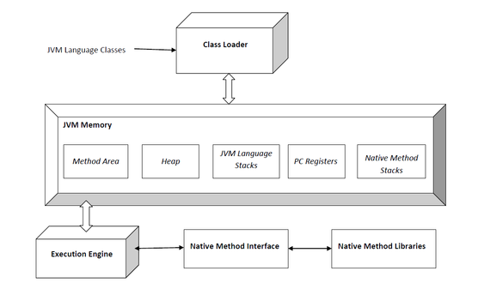
The Java Virtual Machine
Java applications are called WORA (Write Once Run Everywhere). This means a programmer can develop Java code on one system and can expect it to run on any other Java enabled system without any adjustment. This is all possible because of JVM.

Slide 98
The Java Virtual Machine
Java responsible for three activities.
Loading
Linking
Initialization
Loading : The Class loader reads the .class file, generate the corresponding binary data and save it in method area.
Linking : Performs verification, preparation, and (optionally) resolution.
Initialization : In this phase, all static variables are assigned with their values defined in the code and static block(if any). This is executed from top to bottom in a class and from parent to child in class hierarchy.

Slide 99
Exokernels
Rather than cloning the actual machine, as is done with virtual machines, another strategy is partitioning it, in other words, giving each user a subset of the resources.
At the bottom layer, running in kernel mode, is a program called the exokernel. Its job is to allocate resources to virtual machines and then check attempts to use them to make sure no machine is trying to use somebody else’s resources.

Slide 100
The World According to C
The C language
Header files
Large programming projects
The model of run time
Tanenbaum, Modern Operating Systems 3 e, (c) 2008 Prentice-Hall, Inc. All rights reserved. 0-13-6006639

Slide 101
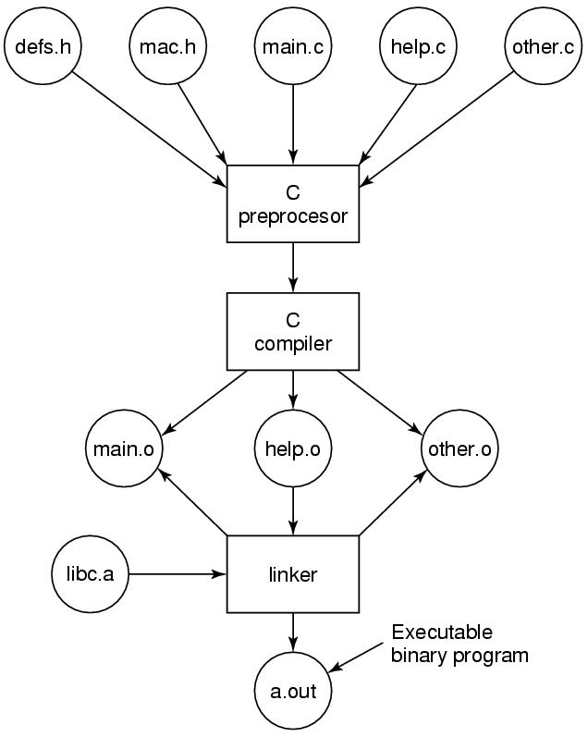
The Model of Run Time
The process of compiling C and header files to make an executable.

